Slide 1
Historical Pandemics
By Jonathan Laredo

Slide 2
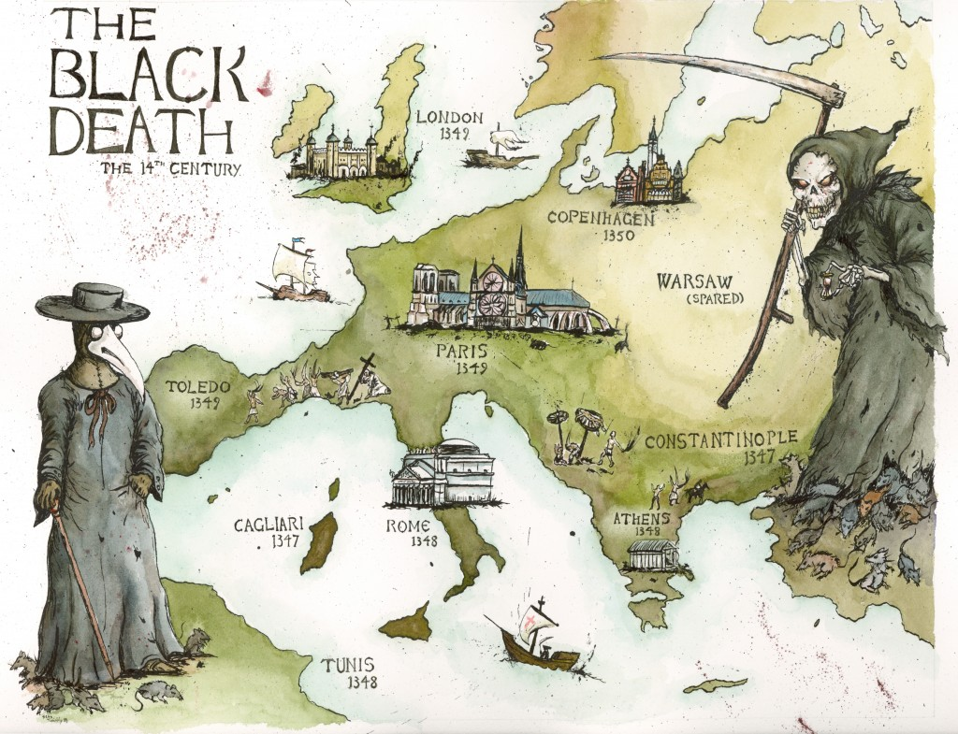
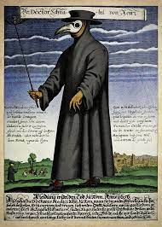
History of Pandemics
Pandemic is a global outbreak of a new virus that is currently unknown
Earliest recording of a pandemic happened in 430 B.C.: Athens during the Peloponnesian War. As much as ⅔ of the population died
There have been 249 Pandemics recorded throughout history
Most deadliest pandemic in history is the Black Death
WHY

Slide 3
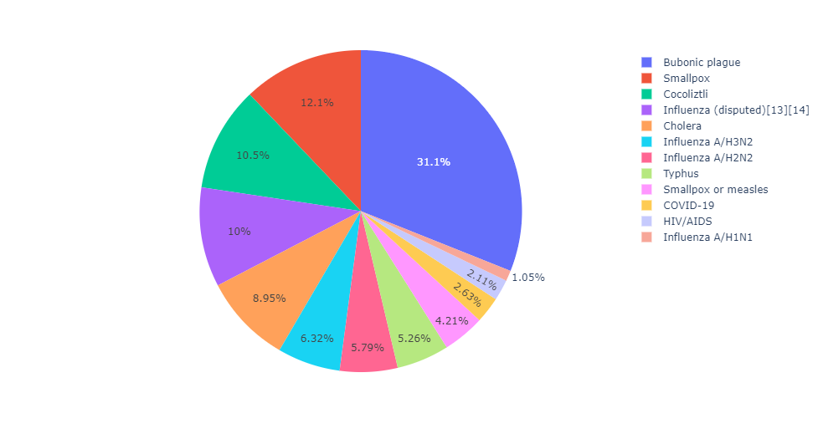
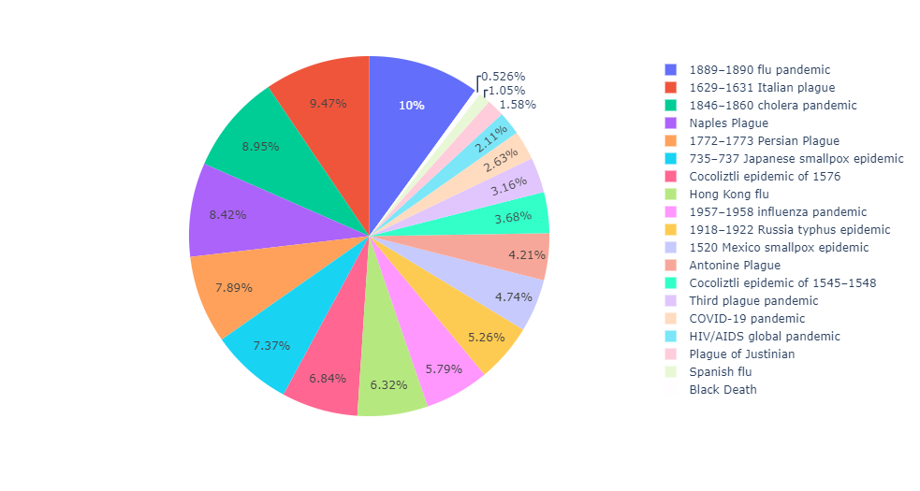
Diseases In History
Epidemics/pandemics
Disease

Slide 4
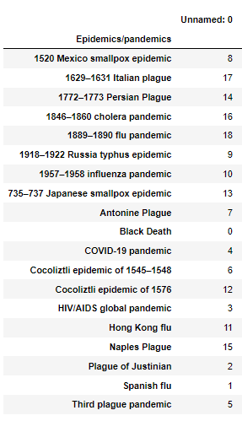
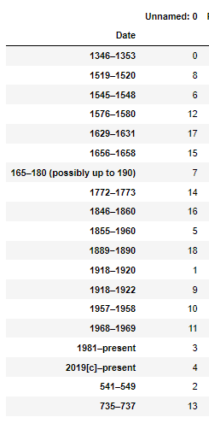
Ranking of the Deadliest
Ranking
Wanted to find out which years were the deadliest
The Epidemics is matched with the year the disease was happening
1346 - 1353 The era of the Black Death
1918 - 1920 The era of the Spanish flu

Slide 5
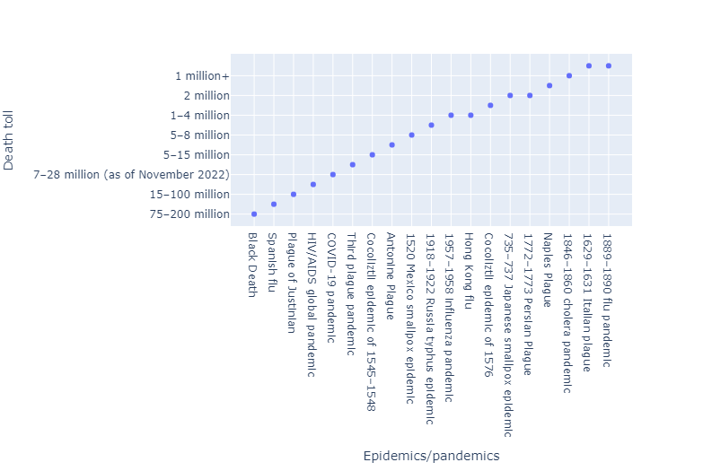
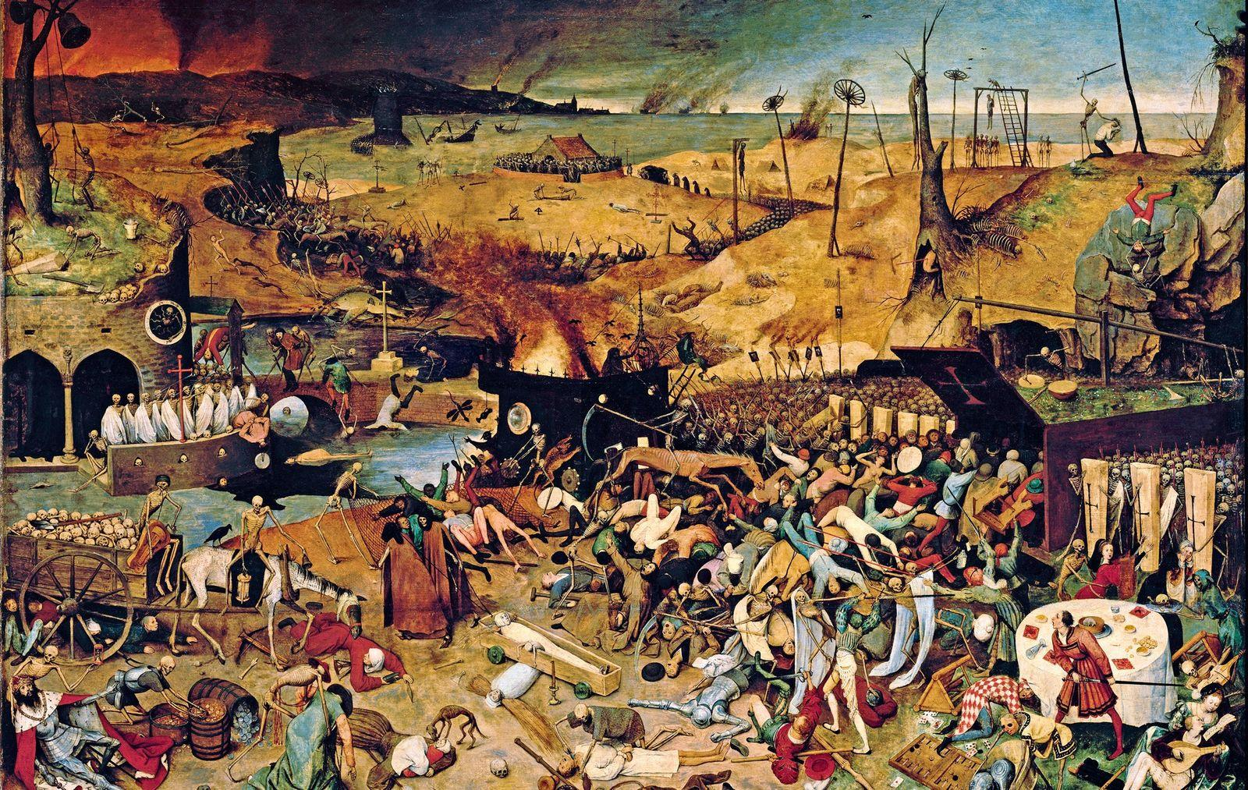
Rank of each Pandemic
Wanted to Rank and find out which was the most deadliest diseases in history
The Black Death is Ranked as the deadliest Epidemics in history.

Slide 6
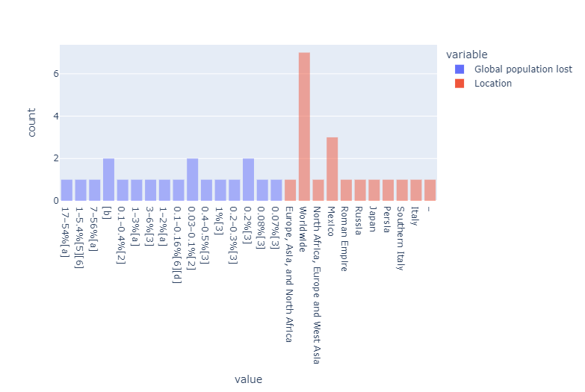
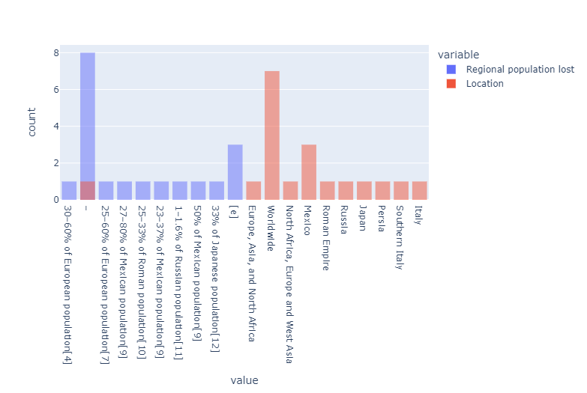
Location population lost
Global population lost
Regional population lost

Slide 7
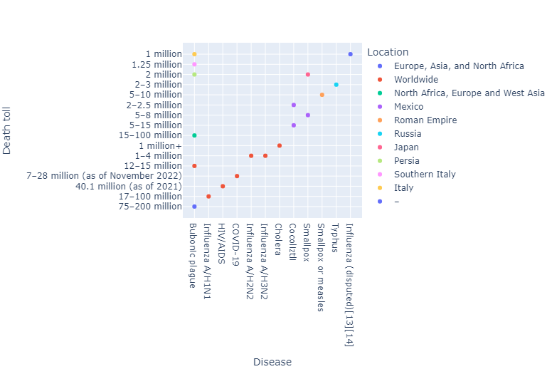

Specific countries total lost
Created an interactive graphs that allows the user to view how many deaths happened in a specific country
Took the location of each pandemics ground zero to see how it affected the population

Slide 8
The End

